Slide 1



ULTRASONIC SENSORS
ARDUINO SET UP

Slide 2
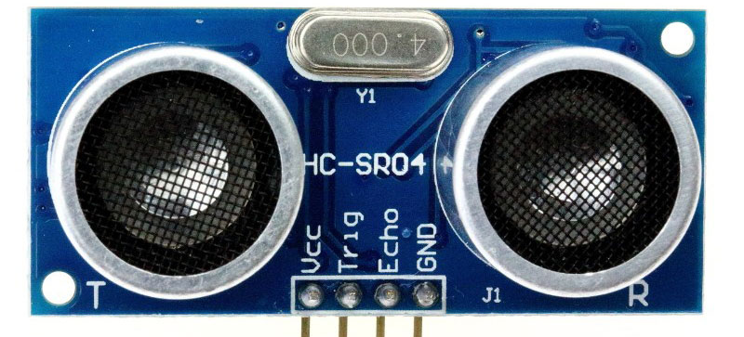
ULTRASONIC SENSORS
Definition:
These are sensors that measure distances by means of ultrasonic waves. It consists of an emitter and a receiver.
There are two other pins for the echo and and triggering the sensor.

Slide 3
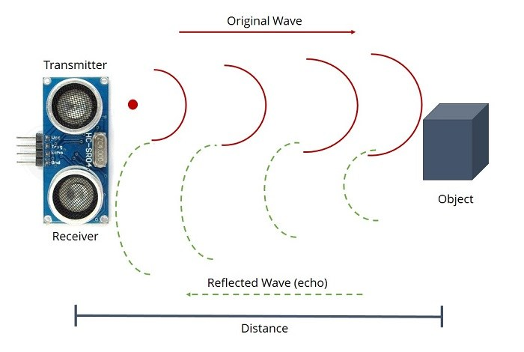
Functioning of the sensor
C is the sonic speed
T is the time between emission and reception
This sensor works based on three factors, which are distance, time and speed.
What happens here is the sensor is triggered then the it releases an echo whereby the time by which this echo takes to reach the emitter and back is measured, then the data is used to calculate the distance which is what we want.
Here is how its calculated L = ½*T*C
L is the distance between sensor and object

Slide 4

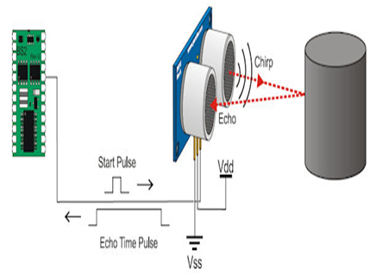
Characteristics of the sensor
It can reflect of transparent objects like glass or liquid.
Resistant to dirt and mist accumulation as it is not affected by this .
It can also detect complex shaped objects such as mesh trays or springs
This is just to name a few characteristics.

